Slide 1
Pacific-Europe Network for Science, Technology and Innovation
speaker’s name

Slide 2
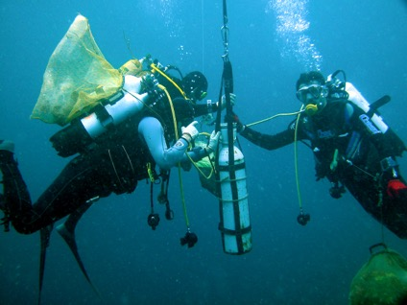
Contents
Project Characteristics
Project Partners
Societal Challenges
Pacific-EU Policy Context
Main Objectives
Project Structure
Networking Platform and Partnership Tool

Slide 3

1. Project Characteristics
From FP7 to Horizon 2020: EU objectives
Excellence and attractiveness in ST&I
Economic – industrial competitiveness
Addressing societal challenges
Supporting the Union’s external policies
PACE-Net Plus
Broad partnership of 16 members
Coordinated by IRD (Institut de Recherche pour le Développement)
3 year project with a budget of €3 million

Slide 4
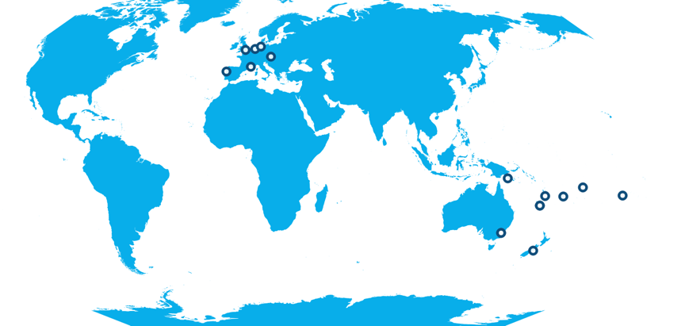













2. Project Partners

Slide 5
3. Societal Challenges
Challenge 1: To support better health for all, ways of dealing with demographic change and improved well-being
Challenge 3: To support action on climate change, environmental protection, resource efficiency as well as a sustainable supply and use of raw materials
Challenge 2: To contribute to increasing food security, promoting sustainable agriculture and forestry, marine and maritime and inland water research and accelerating the transition to a sustainable bioeconomy

Slide 6
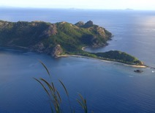
4. Pacific-EU Policy Context
Raising the EU’s profile in the Pacific region
Geostrategic importance of the Pacific-EU partnership
“Towards a renewed EU-Pacific development Partnership” (21/03/2012)
Council conclusions on a renewed EU-Pacific development partnership (14/05/2012)
Pacific ocean - a major driver of global climate & fish production with vast deep sea mineral deposits
Specific challenges faced by Pacific Island Countries and Territories (PICTs)
Limited & uneven national capacity to address science, technology and innovation (ST&I) constraints
Sustainability of environments, economies and cultures

Slide 7

4. Pacific-EU Policy Context
Opportunity for Pacific ICTs & Overseas Countries and Territories (OCTs) to:
Improve regional cooperation and integration, as encouraged by the Pacific Plan for Regional Integration and Cooperation 2005-2015 (Pacific Islands Forum)
Better address the ST&I challenges to support sustainable regional development needs
Increase regional ST&I capacities, opportunities and reinforce networking
Enhance bi-regional ST&I networks addressing global challenges

Slide 8
5. Main Objectives
Main objectives
1. Reinforcing Pacific-EU ST&I cooperation by focusing on 3 major societal challenges
2. Enhancing cooperation on innovation issues
3. Strengthening Pacific-EU research cooperation partnerships
4. Supporting bi-regional policy dialogue in ST&I between the EU and the Pacific region

Slide 9
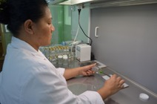
5. Main Objectives
1. Reinforcing Pacific-EU ST&I cooperation by focusing on 3 major societal challenges
Deliver information
updating state of the art (ST&I cooperation, key stakeholders)
watching (events, opportunities)
Identify / update priority areas for Pacific-EU cooperation & innovation niches
Promote joint activities

Slide 10
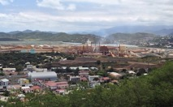
5. Main Objectives
2. Enhancing cooperation on innovation issues
Identifying factors underlying innovation processes
Facilitating the development of industrial innovation in the Pacific (possibilities and vulnerabilities)
Promoting EU-Pacific cooperation through innovation niches (opportunities and challenges)
Supporting economic mutual interests of the Pacific and the EU

Slide 11

5. Main Objectives
3. Strengthening Pacific-EU research cooperation partnerships
Through the promotion of EC and Member States & Associated Countries’ programmes, among the Pacific research community
Through the promotion of Pacific opportunities for EU researchers
With a special focus on Horizon 2020

Slide 12
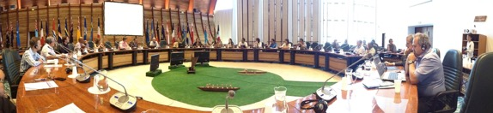
5. Main Objectives
4. Supporting bi-regional policy dialogue in ST&I between the EU and the Pacific region
Helping in structuring the ST&I dialogue framework at regional and national level
Building synergies with existing initiatives (from EU & Pacific, e.g. climate change)
Strengthening the bi-regional dialogue between stakeholders and high level policy, particularly on global and regional priorities of mutual importance

Slide 13
6. Project Structure
WP7: Coordination – management, communication and dissemination
WP1: Cooperation in Health, demographic change and well-being
WP2: Cooperation in Food security, sustainable agriculture and forestry, marine and maritime and inland water research, and the bioeconomy
WP3: Cooperation in Climate action, environment, resource efficiency and raw materials
WP6: Support the bi-regional policy dialogue in ST&I
WP5: Strengthening Pacific-EU research cooperation partnerships
WP4: Enhancing cooperation on innovation issues to tackle the societal challenges

Slide 14
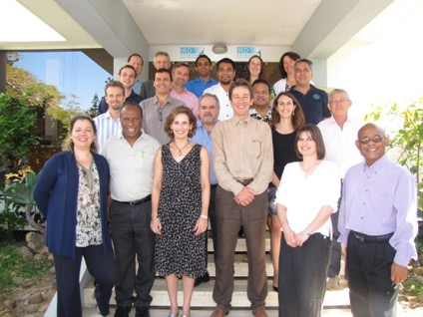
7. Networking Platform and Partnership Tool
Science, technology and innovation for:
the bi-regional dialogue
promoting bi-regional projects between the EU and the Pacific
regional cooperation and integration
industrial competitiveness & sustainable economy
tackling societal challenges

Slide 15
Contact
Project coordination:
Institut de Recherche pour le Développement – IRD, France
Prof. Jean-François Marini
Email: jean-francois.marini@ird.fr

